Slide 1

AI RESUME SCREENING & CANDIDATE RANKING SYSTEM
AI Resume Screening & Candidate Resume Screening
Under the guidance of Name: Saomya Chaudhury

Slide 2
Course Outline
AI RESUME SCREENING & CANDIDATE RANKING SYSTEM
Problem Statement
Proposed Solution
Software Requirement
System Architecture
Project plan
Video of the project
Future Scope
Conclusion

Slide 3
Problem Statement
AI RESUME SCREENING & CANDIDATE RANKING SYSTEM
Recruiters are overwhelmed by the high volume of resumes received for every job opening. The manual screening process is time- consuming, inconsistent, and prone to biases leading to inefficient hiring processes and potentially overlooking qualified candidates. To address these challenges, there is a need for an AI-powered Resume Screening & Candidate Ranking System that leverages Natural Language Processing (NLP) and Machine Learning techniques. This system aims to efficiently and accurately analyze resumes, extracting relevant information such as skills, experience, and education, and ranking candidates based on their suitability for the job.

Slide 4
Proposed Solution
AI RESUME SCREENING & CANDIDATE RANKING SYSTEM
To address the challenges of inefficient and biased resume screening, we propose developing an AI-powered Resume Screening & Candidate Ranking System utilizing Natural Language Processing (NLP) and Machine Learning techniques. The system will automatically parse and analyze resumes, extracting key information such as skills, experience, education, and relevant keywords. Using machine learning algorithms, it will score and rank candidates based on their suitability for the job requirements, providing recruiters with a prioritized list of top applicants. The system aims to enhance efficiency by significantly reducing the time required for initial screening, ensuring consistency and transparency in evaluations, and minimizing biases in the recruitment process.

Slide 5
AI RESUME SCREENING & CANDIDATE RANKING SYSTEM
Software Requirement
Operating System: Windows 11 IDE: Jupyter Notebook Language: Python

Slide 6
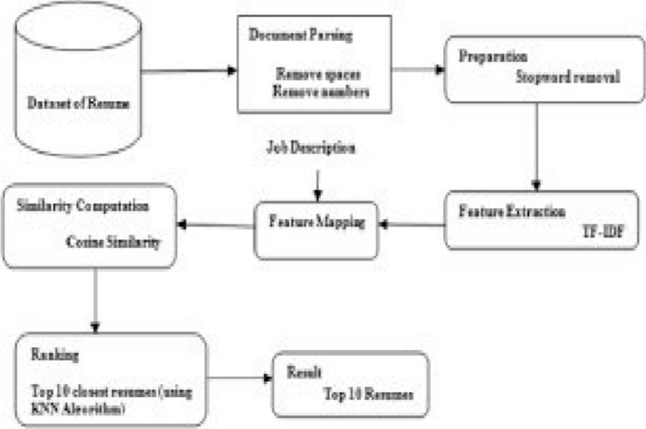
AI RESUME SCREENING & CANDIDATE RANKING SYSTEM
System Architecture

Slide 7
Project plan
AI RESUME SCREENING & CANDIDATE RANKING SYSTEM
The proposed AI-powered Resume Screening & Candidate Ranking System will be developed in several phases. This will be followed by Data Collection & Preprocessing, where relevant resume data will be gathered, cleaned, and prepared. During the System Design & Model Development phase, NLP models and ranking algorithms will be built to analyze and score resumes. The Implementation & Integration phase will focus on developing a Streamlit interface and integrating the system with existing recruitment tools.

Slide 8
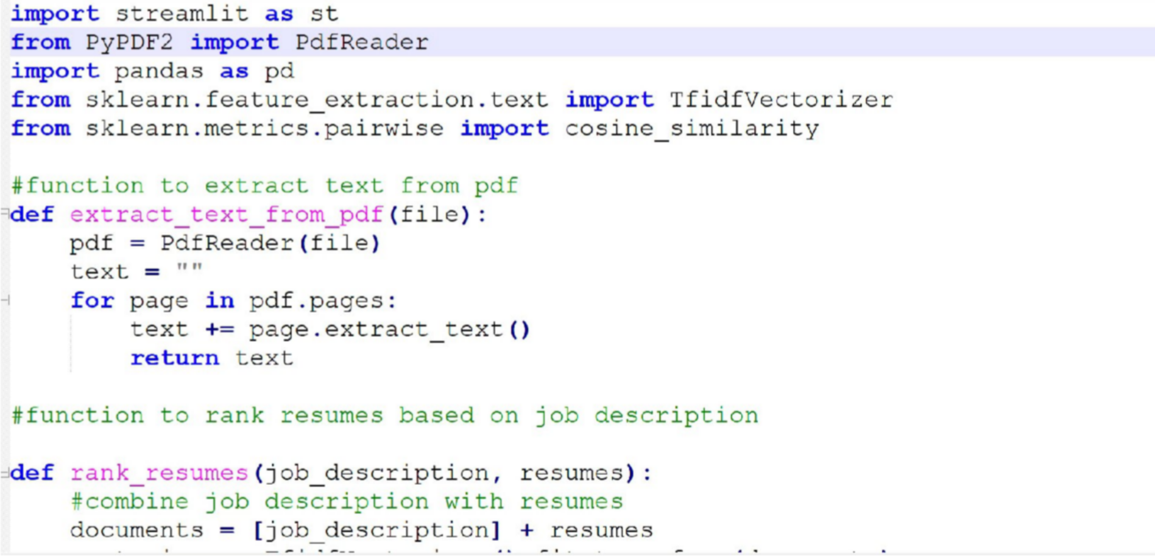
AI RESUME SCREENING & CANDIDATE RANKING SYSTEM
Video of the project

Slide 9
Future Scope
AI RESUME SCREENING & CANDIDATE RANKING SYSTEM
The AI-powered Resume Screening & Candidate Ranking System has the potential for significant enhancements and broader applications in the future.Additionally, incorporating advanced machine learning techniques, such as transfer learning and explainable AI, can enhance the system’s accuracy and transparency. The system can also be extended to support multilingual resume parsing and ranking, making it applicable to global recruitment. Furthermore, integration with applicant tracking systems (ATS) and real-time feedback mechanisms can improve the user experience for recruiters.

Slide 10
Conclusion
AI RESUME SCREENING & CANDIDATE RANKING SYSTEM
The proposed AI-powered Resume Screening & Candidate Ranking System aims to streamline the recruitment process by leveraging Natural Language Processing (NLP) and Machine Learning techniques. By automating resume analysis, ranking candidates based on
relevance, and providing
system
unbiased, consistent, and addresses the limitations of
efficient manual
assessments, the
screening. Its integration into existing recruitment workflows can significantly enhance hiring efficiency, reduce costs, and improve the quality of candidate selection. With future improvements and broader applications, this system has the potential to become a valuable tool for various recruitment and assessment processes.

Slide 11
AI RESUME SCREENING & CANDIDATE RANKING SYSTEM
THANK YOU

